Slide 1
TabTransformer project
Lasse Nordqvist

Slide 2
Project overview
Objective: Predicting the risk of late deliveries for a sports retailer using TabTransformer, a transformer architecture specifically designed for the analysis and modeling of tabular data
Target Variable: Late_delivery_risk.
1 (Late): Realized delivery time is greater than scheduled time.
0 (On Time): Realized delivery time is equal or less than scheduled time.
Architecture: TabTransformer, a model that applies Transformer layers to categorical feature embeddings before combining them with numerical data for final classification.
Dataset: ~180,000 rows of orders from a sports retailer, with 53 features related to the orders

Slide 3
Data pre-processing
Dropped features that:
Contain metadata (customer identification etc.)
Categorical features that have high cardinality (customer city, street etc.)
Features that are inferred from the target feature and risk data leakage (delivery status, realized order time etc.)
Contain missing values
80/10/10 train-test-validation split was done before statistical tests to avoid data leakage
Feature selection was done utilizing statistical tests to measure the statistical significance
Label encoding used for categorical features for the embedding, done after split to avoid data leakage

Slide 4
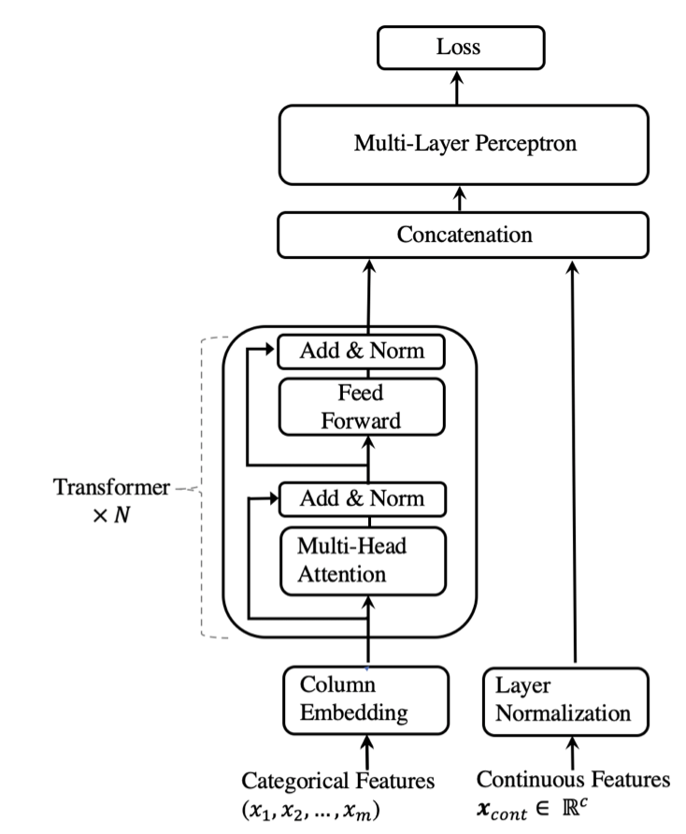
TabTransformer architecture
(Huang et al. 2020)
Own transformer architecture implemented, based on previous implementations. Main architecture components:
Embedding layers creates fixed sixe embedding vectors of categorical features (embed_dim = 32)
2 transformer blocks with 4 attention heads
Multi-Head attention mechanism with Add & Norm
Followed by Feed Forward network and Add & Norm
Transformer output is concatenated with numerical features and then batch normalized to be used as input to MLP
MLP with three layers (128, 64 and 1 neuron) is used to create a probability of the binary class
Based on probability, a prediction for the target label is made

Slide 5
Model training
‘Late’ label was given 1.5x the weight compared to ‘On time’ during training
AdamW optimizer
Binary-Cross entropy as loss function
Early stopping to avoid over-fitting, model reached convergence ~25 epochs

Slide 6
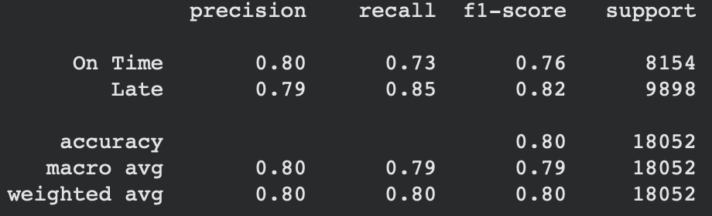
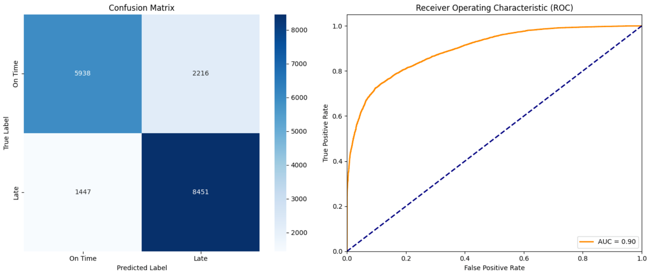
Results & future improvement
For a business use case, main performance metric ‘Late’ label recall, 0.85
‘Late’ label weighing allowed better performance for ‘Late’ label
Future improvements
Hyperparameter tuning (not done due to computational time)
Tuning of prediction threshold (now base value 0.5 used)
Refined statistical tests that for transformers

